Slide 1
Microsoft identity platform Overview
1

Slide 2
Let’s start with some code
2

Slide 3
What Microsoft identity platform does for developers
Authenticates users
UserID and Password, MFA, Passwordless
Authorizes applications to access resources
Robust directory data with Microsoft Graph
Access to the data that drives productivity across Microsoft 365
Provision users to the app
Verifies app publishers
Developers delegate Identity and Access Management to Microsoft Identity

Slide 4
What Microsoft Identity does
Frictionless user experience through single sign-on (SSO)
Automated provisioning workflows to reduce IT costs
Real-time machine learning guards against use of leaked or stolen credentials and blocks suspicious login attempts
Identity governance controls access to apps and data for all users, including privileged users, across hybrid environments
And much more….
Ability to enforce strong risk-based access policies with identity protection and Conditional Access

Slide 5








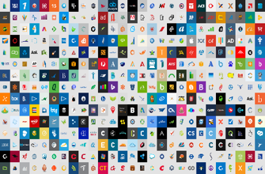



Conditional Access + Identity Protection
Azure AD
ADFS
Conditions
Controls
MSA
171TB
Google ID
Employee & Partner Users and Roles
Session Risk
Allow/block
access
Microsoft Cloud
Android
iOS
Trusted & Compliant Devices
Machine learning
3
MacOS
Limited
access
Microsoft Cloud App Security
Windows
Windows Defender ATP
Require
MFA
Real time Evaluation
Engine
Cloud SaaS apps
Physical & Virtual Location
Force
password
reset
Geo-location
******
Corporate Network
Policies
Effective policy
Client apps & Auth Method
Block legacy authentication
Browser apps
Client apps
On-premises & web apps

Slide 6
Cloud Identity Provider
6

Slide 7
Cloud Identity Provider
Available to any app anywhere
Access to https://login.microsoftonline.com required
7

Slide 8



Cloud Identity Provider
Available to any app anywhere
Access to https://login.microsoftonline.com required
WS-Federation
8

Slide 9
Protocols do not guarantee security, Developers do
Modern protocols have flaws:
Token replay to client (implicit Grant) – Nonce
Token replay to server – Timestamps, session IDs
Token caching
Token lifetimes
Make sure your developers are using a library or are fully invested in implementing the protocol and its recommendations
Microsoft Libraries (MSAL) best choice when using Microsoft identity platform

Slide 10








Microsoft identity platform for developers
Build applications and integrate identity with one unified toolkit
Azure portal and
Microsoft Graph App API
Microsoft Authentication Libraries
For clients and services
App registration
Libraries
Web API
Including Microsoft Graph, Azure, and your own APIs
OIDC Certified Endpoints
Web API
Endpoints
Work and school accounts
Azure AD
Personal accounts
MSA
Customer and Partner accounts
Supported identities
Azure AD External Identities (includes Azure AD B2C)
Industry standards

Slide 11








Microsoft Authentication Libraries (MSAL)
JavaScript
.NET
Android
iOS
Python
Java
Angular
Microsoft Identity Web
https://docs.microsoft.com/en-us/azure/active-directory/develop/msal-migration

Slide 12
Fast and simple integration Authentication libraries
Secure access to users and data made simple
Microsoft’s (Microsoft Graph, other APIs)
Your own APIs
MSAL - best in class auth libs
Reach any audience
Follows Microsoft Security Development Lifecycle
ADAL (and Azure AD Graph) end of support June 30, 2022
https://aka.ms/ADALAADGraph
MOBILE APP
CLIENT SDK
12

Slide 13
Users
Identity
Resources
Policies
13

Slide 14
Continuous growth of adoption and usage
200 K +
Azure AD Premium organizations
Thousands of organizations, millions of active users, billions of daily requests
345 M +
Azure AD
Monthly active users
30 B +
Azure AD Daily authentication/authorization requests

Slide 15
External collaboration using B2B
Contoso
Fabrikam
Contoso Content
User A
User B
User B
15

Slide 16








Azure AD for partners and customers
CONNECT WITH CUSTOMERS
COLLABORATE WITH PARTNERS
contoso
Social IDs
Business & Government IDs
16
On-premises & web apps

Slide 17

Microsoft 365 Platform
Extend Microsoft 365 experiences
Build your experience
Documents
Conversations
Portals
Timeline
Search
Web apps
Bots & agents
Device & native
Daemon apps
Workflow automation
Analytics apps
Microsoft Graph API
Microsoft 365
People
Chats
Files
Devices
Mail
Alerts
Lists
Security
Search
Events
17

Slide 18
What is automatic user provisioning?
Allows IT admins to automate the creation, maintenance and removal of user identities in one or more target identity stores.
These actions are based on changes to users/groups in Azure AD or HR profiles.
Also called “Joiner-Mover-Leaver” scenarios
HR Data
User Profile Data
Legal Name
Preferred Name
User ID
Custom Attribute(s)
Job Data
Worker Type
Employee ID
Position Info
Business Title
Work Address
Manager
Company/Division/Department
Dates
Hire Date
First Day of Work
Effective Dates
Last Day of Work
AD, Azure AD and SaaS apps

Slide 19
What is SCIM?
SCIM is an emerging standardized protocol and schema for managing users and groups. More info: http://www.simplecloud.info/
Experienced growth of adoption in 2015-2016 among popular SaaS apps like Workplace by Facebook, Slack, and Github
Many of our pre-integrated connectors in the app gallery happen to use SCIM
We also have a generic connector for non-gallery and custom apps that implement SCIM 2.0. More info: http://aka.ms/SCIM

Slide 20
What we hear from customers
Increased visibility and control
More proactive decisions, easier reactive ones
Systems should keep data safe and reduce decision burden
Accelerated app adoption for trustworthy developers

Slide 21
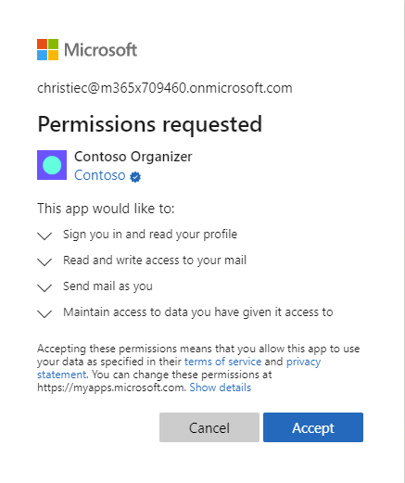

Slide 22
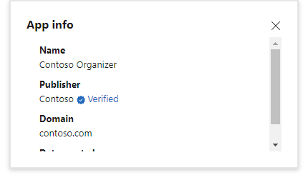

Slide 23
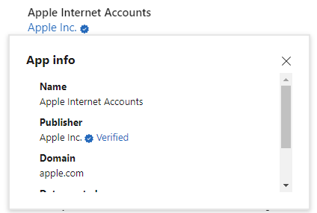

Slide 24

Let’s start with an app
Decisions:
Trust Microsoft identity platform
How will customers trust your app
Work for the user or as the app itself
What resources are required and when
When to ask for permission to a resource
24

Slide 25
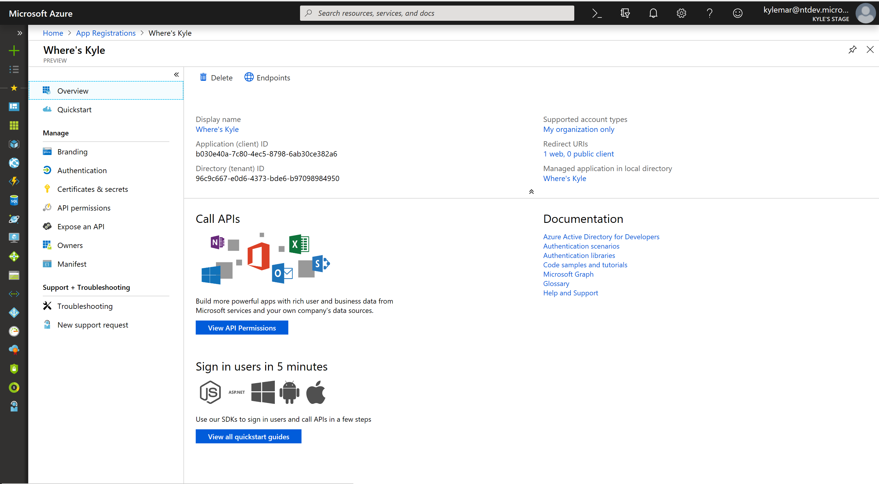
App Registration – App Trusts Microsoft identity platform
What Azure AD considers “the app”
Information about the app:
Name, logo, and publisher
Reply URLs, Secrets, …
One App Registration per App
“Application Object”
25

Slide 26
Demo application registration
26

Slide 27
Single Enterprise App – Users come from only one enterprise
App registered for a specific Azure AD directory
Single-tenant
Registered with Azure Portal, script, automation provided by developer
Admins decide who can register apps in their tenant
27
App

Slide 28

Registering the app is not enough
Need:
User and group application and role assignments
Permissions granted to the application
Policies including conditional access policy
Alternate local settings for an application
Enterprise App
Service Principal
App
SP
28

Slide 29
Making getting your app easier
App registered for use in any Azure Directory or any Azure AD and personal Microsoft accounts (e.g. Skype, Xbox, Outlook.com)
Multi-tenant
Registered in its “Home” directory (same process as single-tenant)
Admins decide who can consent to apps in their tenant
App
SP
29

Slide 30
Making getting your app easier
App registered for use in any Azure Directory or any Azure AD and personal Microsoft accounts (e.g. Skype, Xbox, Outlook.com)
Multi-tenant
Registered in its “Home” directory (same process as single-tenant)
Admins decide who can consent to apps in their tenant
App
SP
SP
30

Slide 31
Demo Enterprise Application
31

Slide 32
Microsoft identity platform
Standards based cloud endpoint
User Authentication
App Authorization
Microsoft Authentication Library family
Microsoft Graph
Provision Users to apps
Verified app publishers
Control Plane for today’s apps

Slide 33
Microsoft identity platform
For Labs and Exercises please refer to the link below -
Getting Started with Microsoft Identity - Learn | Microsoft Docs

Slide 34
34

